Slide 1
Shortest Paths
Dynamic Programming

Slide 2
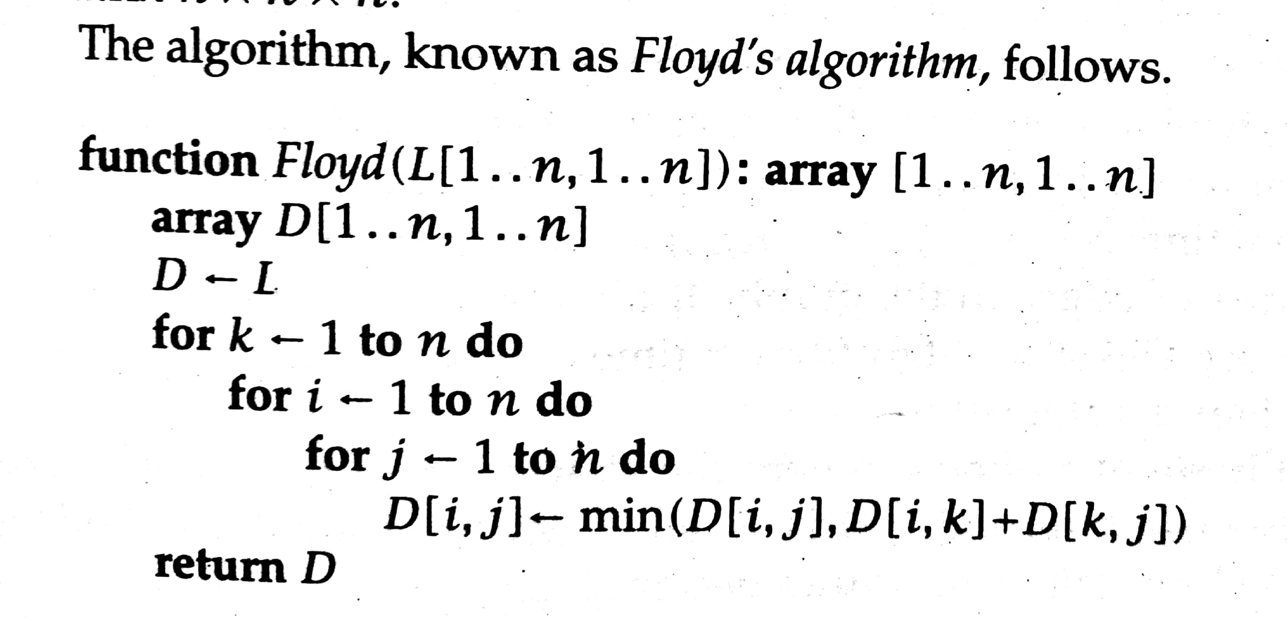
Floyd’s Algorithm

Slide 3
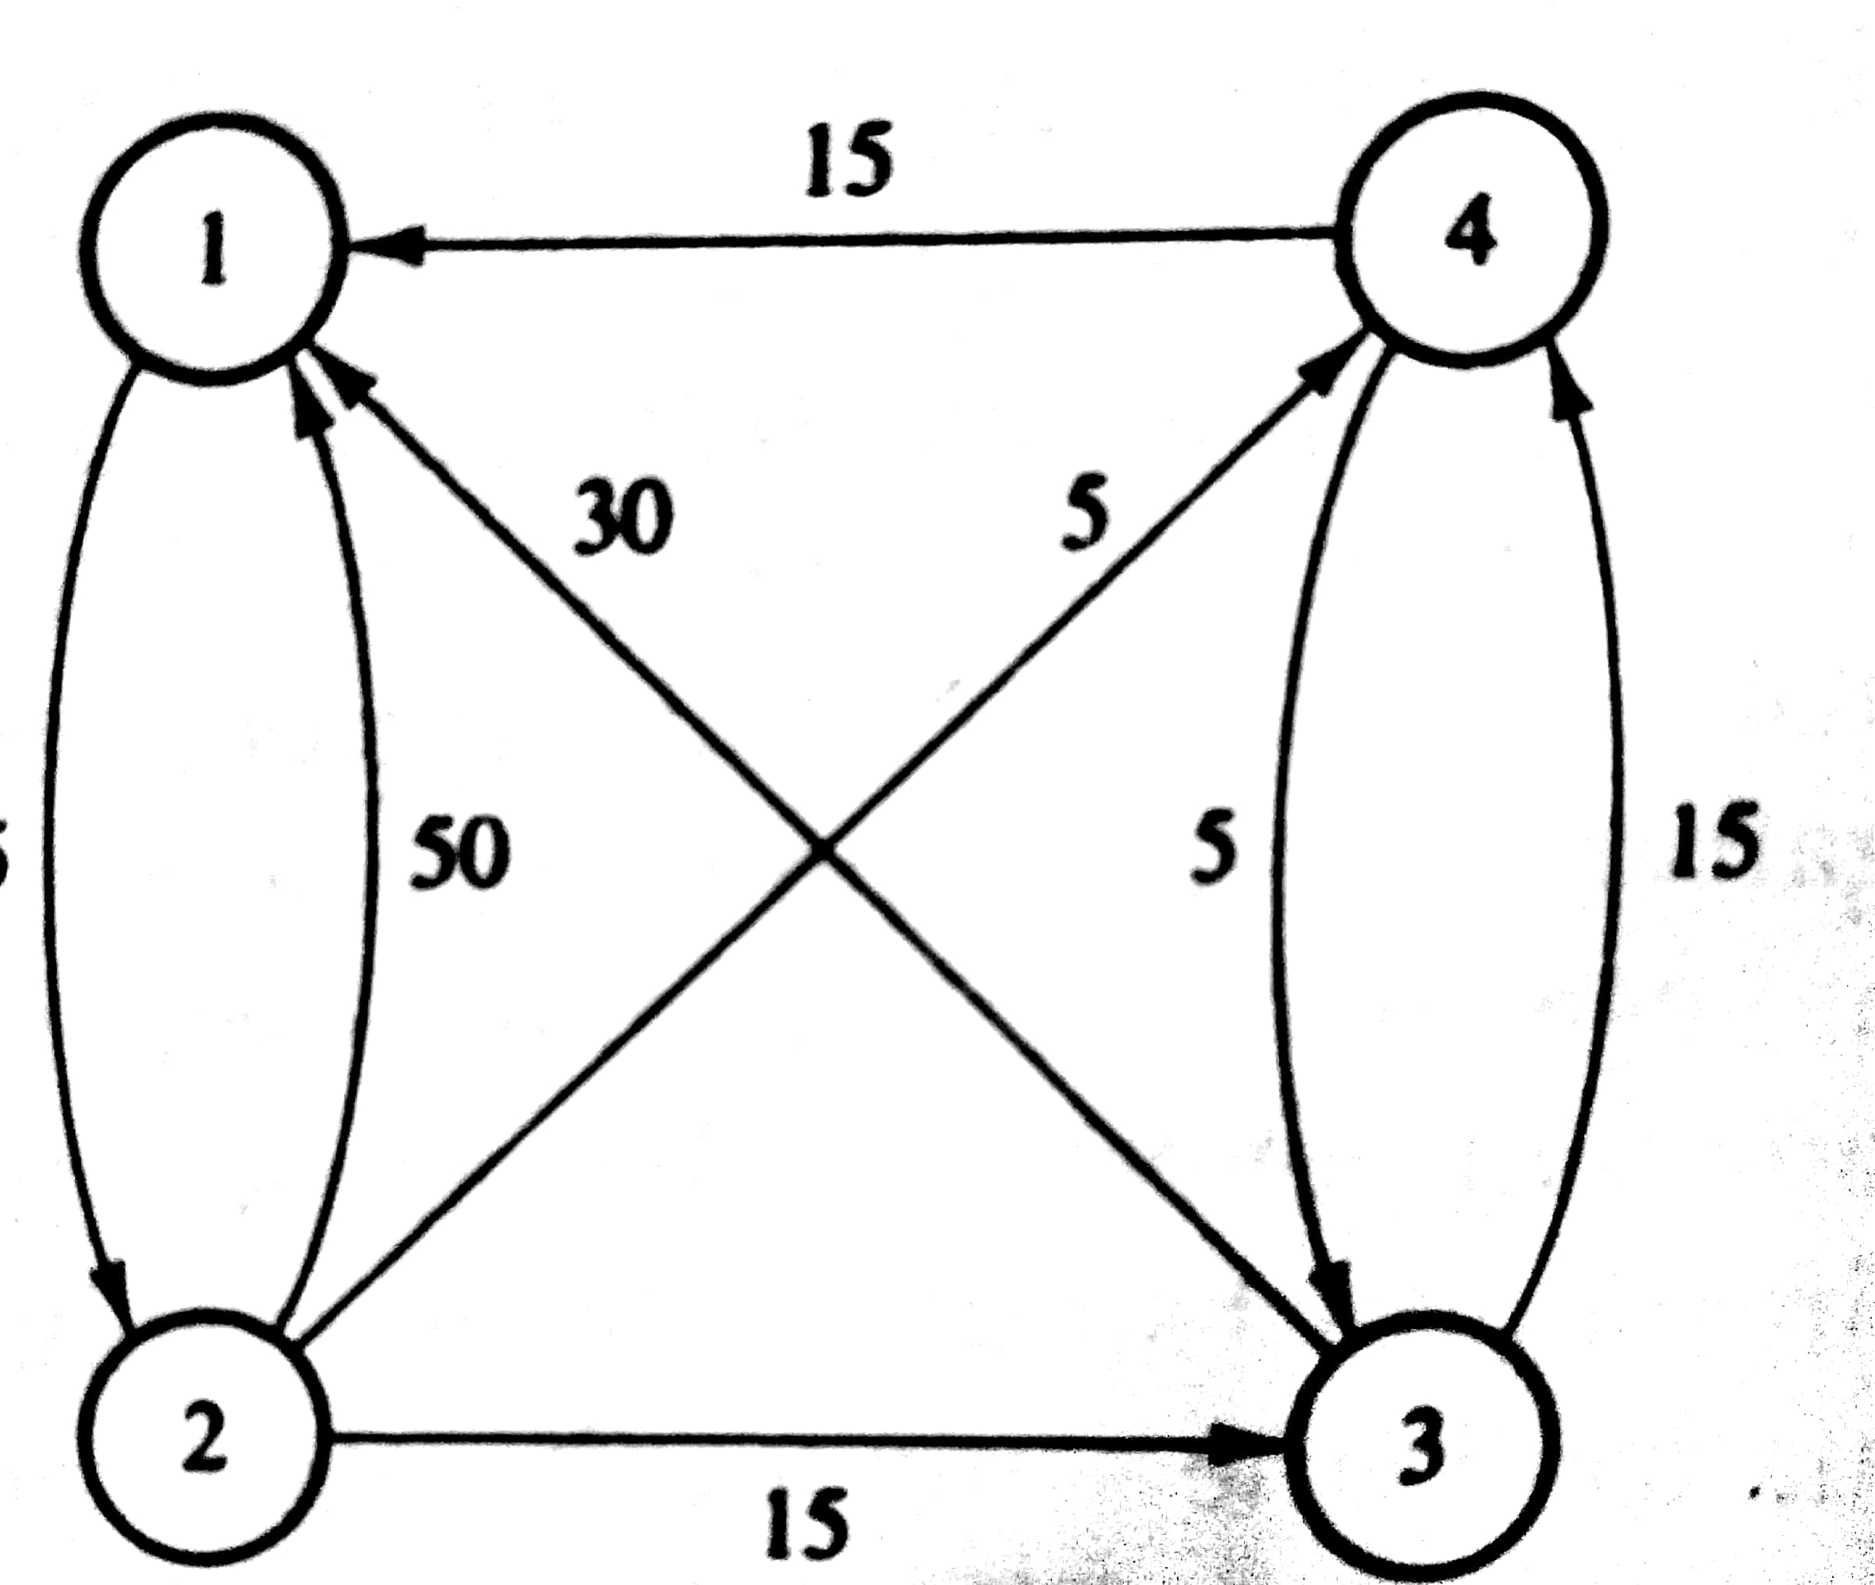

Slide 4
